Slide 1

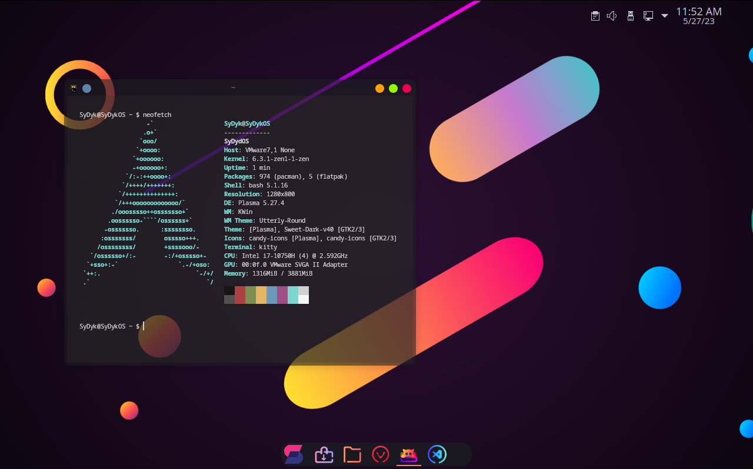



SyDykOS
By: Charbel Bachaalany

Slide 2
Content
01
02
03
04
Introduction
Project Components
Code Overview
- Overview
- Objective & Explanation
- Main Functionalities
- Code Snippets
- Diagram
- Utilized Software & Tools
05
06
User Interface
Results & Future Enhancements
Conclusion
- Screenshots of the GUI
- Results
- Potential future enhancements or development
- Summary

Slide 3
01
Introduction
- Overview
- Objective & Explanation

Slide 4

Introduction
In the world of Linux Distributions, Arch-based systems gained popularity for their cutting-edge software, flexibility, robust community support, and rolling-release system, allowing a one-time installation with continuous upgrades. Paired with the feature-rich KDE desktop environment, and the features provided by the Linux-ZEN kernel, this distro offers an optimized, secure, powerful and customizable computing experience.

Slide 5
02
Project Components
- Utilized Software & Tools

Slide 6








Project Components
Arch-Linux
VMware
KDE-Plasma
Linux-ZEN
VS code
ARCHFI
KONSAVE
BASH
BTRFS
GITHUB

Slide 7
Project Components
VMware
KDE-Plasma
Linux-ZEN
Arch-Linux
Arch Linux is a lightweight and highly customizable Linux distribution that follows a "do-it-yourself" philosophy. It is designed to be simple, minimalistic, and provide users with full control over their system. Arch Linux emphasizes simplicity, elegance, and user-centric design choices.
VS code
ARCHFI
GITHUB
KONSAVE
BASH
BTRFS

Slide 8
Project Components
VS code
VMware
KDE-Plasma
KDE aims to provide a modern, intuitive, and visually appealing desktop environment while maintaining a high level of functionality and flexibility. It is built on the Qt framework, a powerful and versatile application development toolkit.
Arch-Linux
Linux-ZEN
BASH
GITHUB
ARCHFI
KONSAVE

Slide 9
Project Components
VMware
KDE-Plasma
Linux-ZEN
Linux-ZEN is a modified version of the Linux kernel that is specifically optimized for security and multimedia performance. It is a variant of the mainline Linux kernel and includes patches and optimizations to improve responsiveness, reduce latency, and enhance overall system performance.
Arch-Linux
VS code
BASH
GITHUB
ARCHFI
KONSAVE

Slide 10
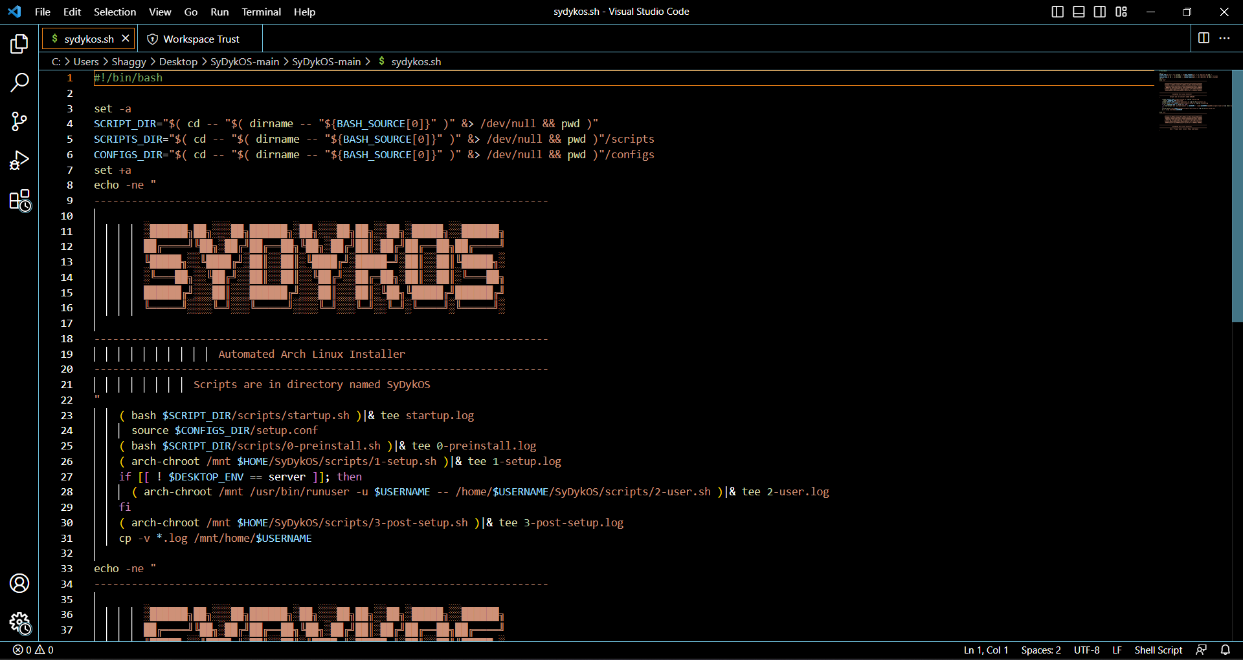
Code Overview
03
- Main functionalities
- Code snippets
- Diagram

Slide 11
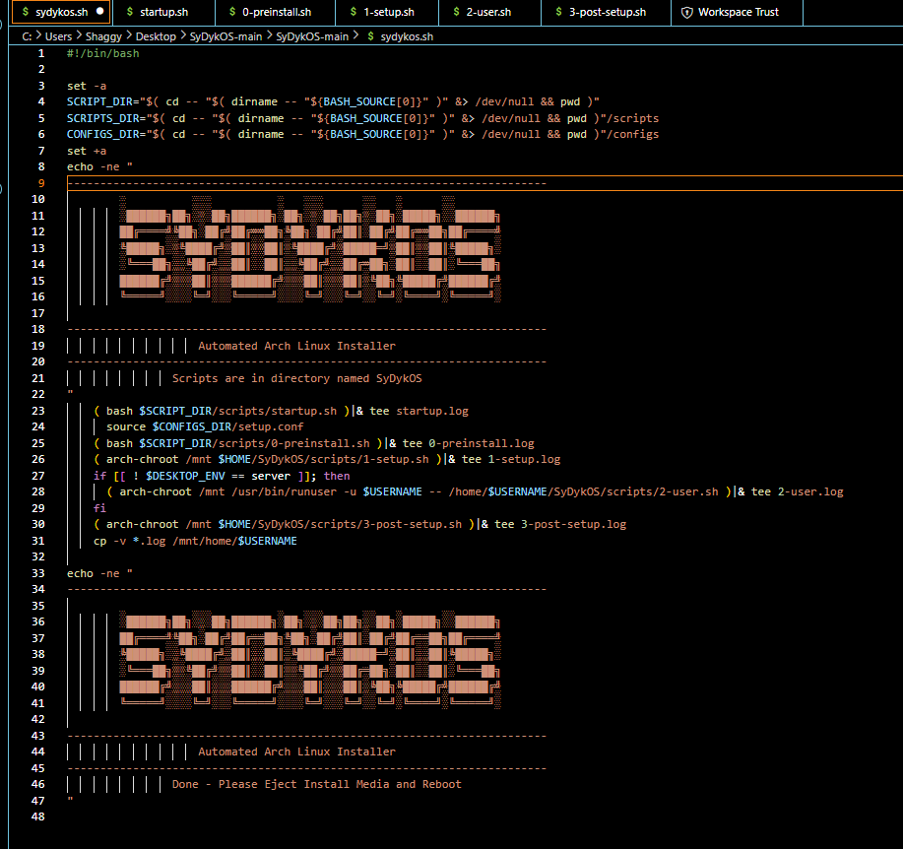
Code snippets
sydykos.sh
The script automates SyDykOS’s installation process by executing various setup scripts inside a chroot environment. It also captures the output of each script in separate log files.

Slide 12
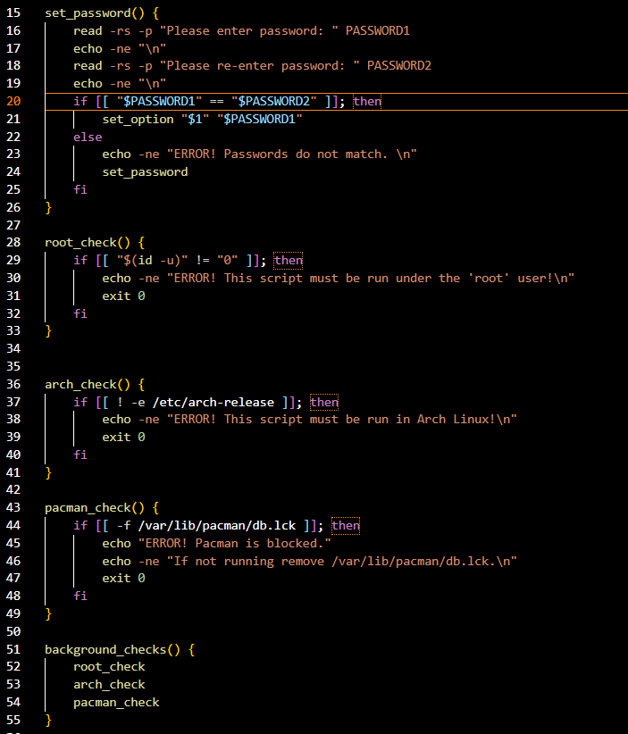
startup.sh
Set password and run background checks.

Slide 13
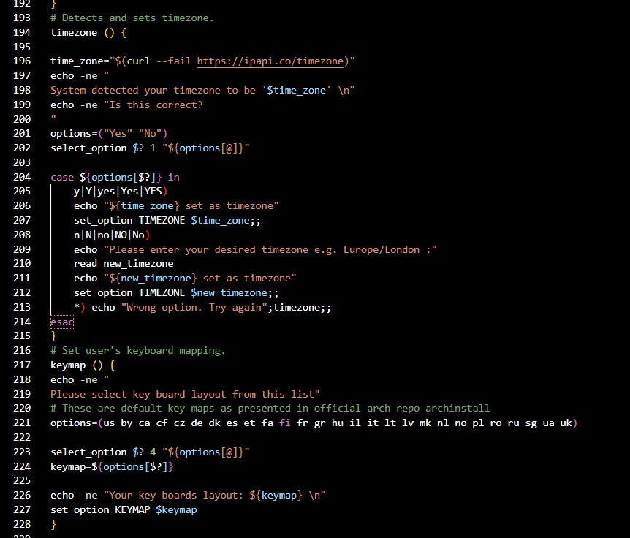
startup.sh
Detect and set timezone and set user keyboard mapping.

Slide 14
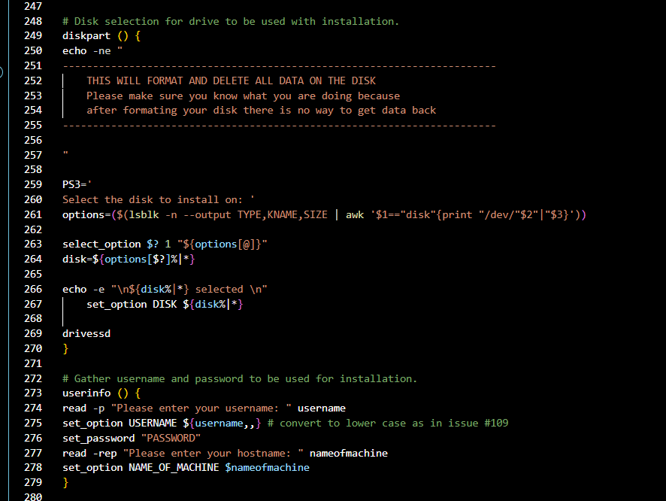
startup.sh
Disk selections, set username and password.

Slide 15
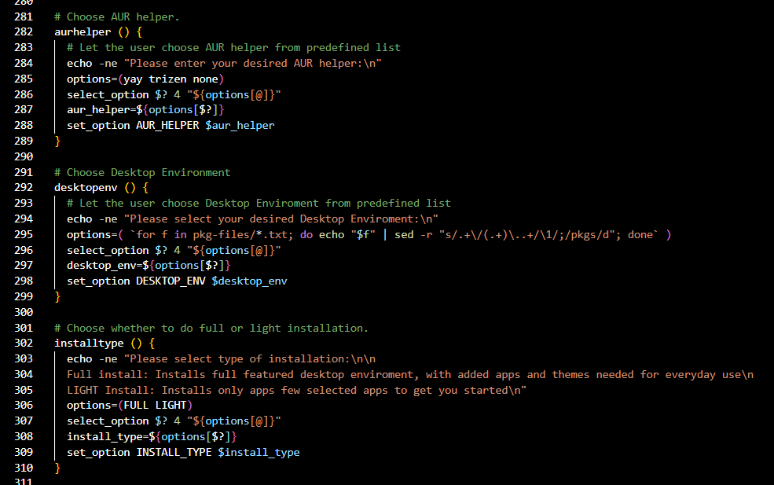
startup.sh
Select AUR helper, Desktop Environment, and option between a full or light install.

Slide 16
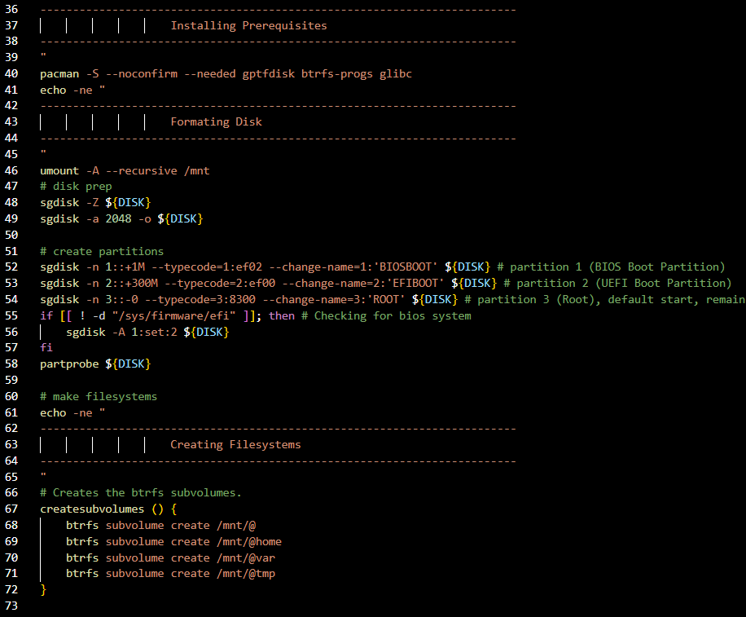
0-preinstall.sh
The preinstall script sets up mirrors, filesystem, installs grub and formats the disk.

Slide 17
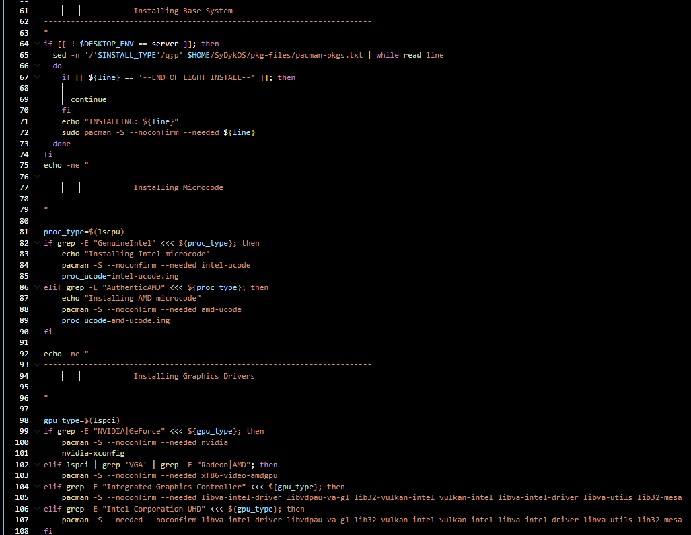
1-setup.sh
The setup script sets up the selected base system, and installs the required GPU drivers and CPU microcode.

Slide 18
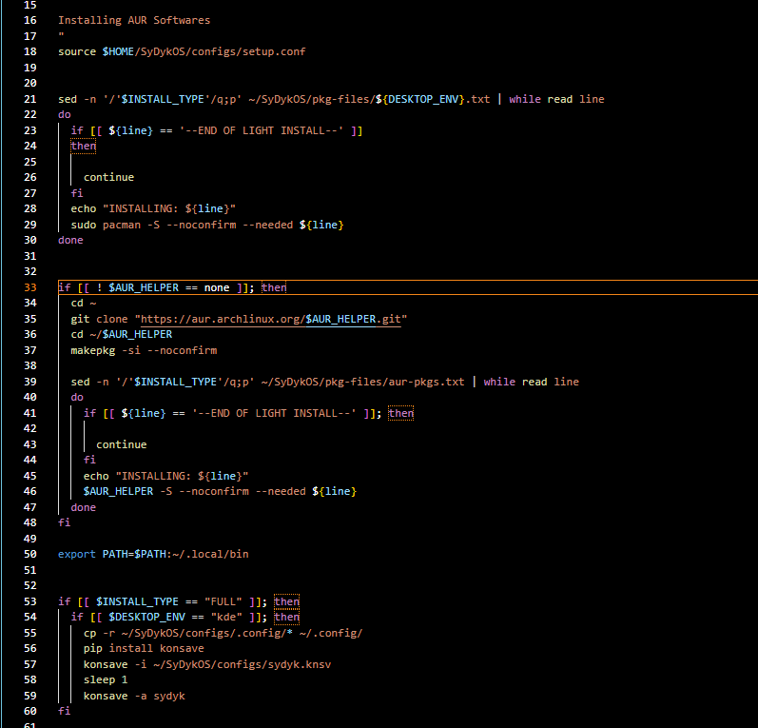
2-user.sh
The script sets up the AUR helper and the konsave file for KDE.

Slide 19
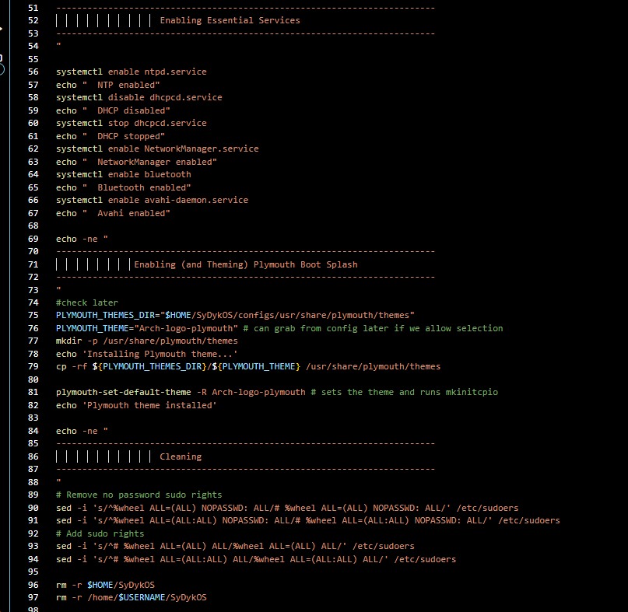
3-post-setup.sh
The script enables essential services, theming, login display, and performs a cleanup task.

Slide 20
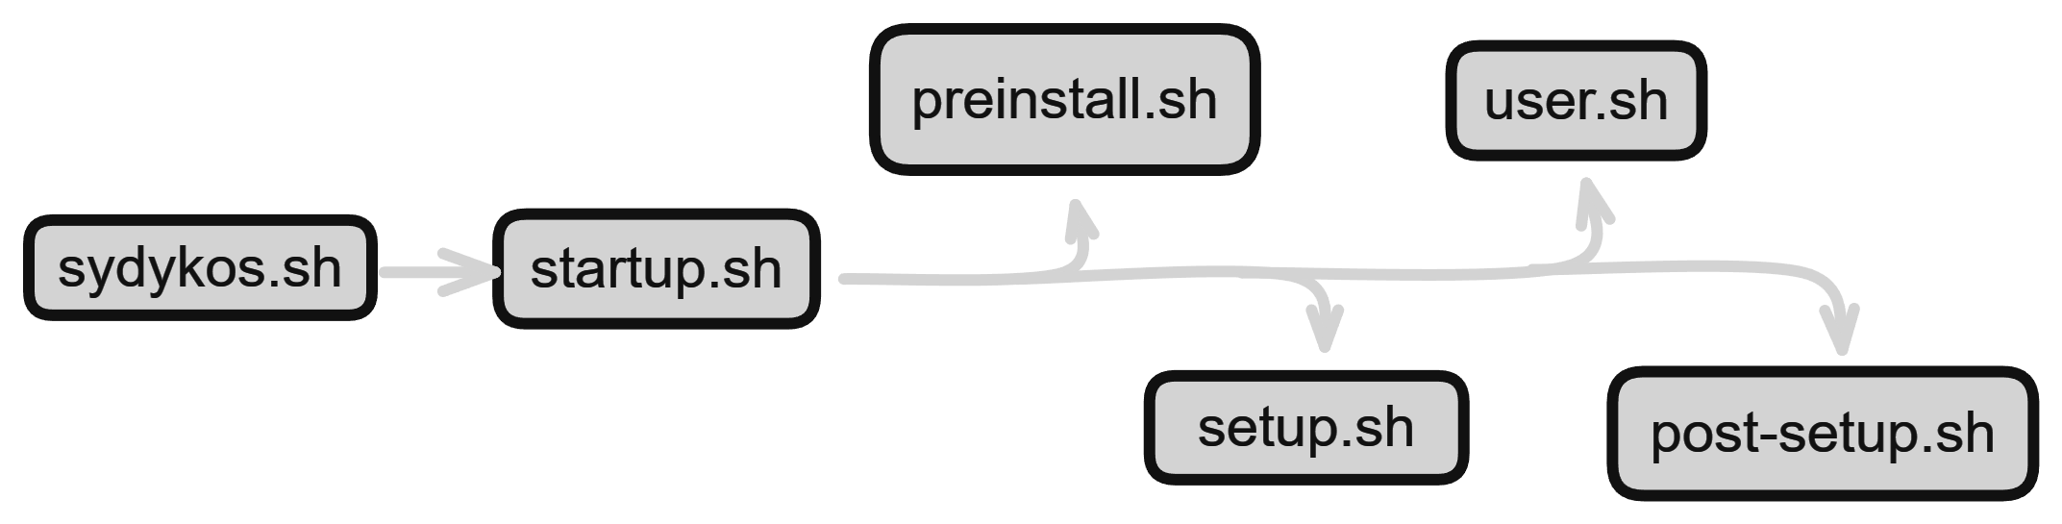
Diagram

Slide 21
04
User Interface
- Screenshots of the GUI

Slide 22
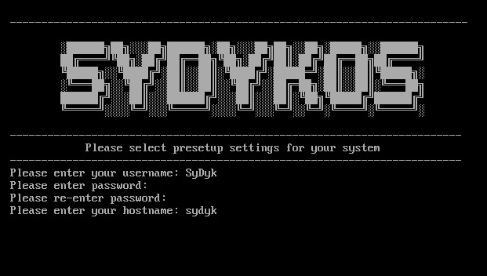
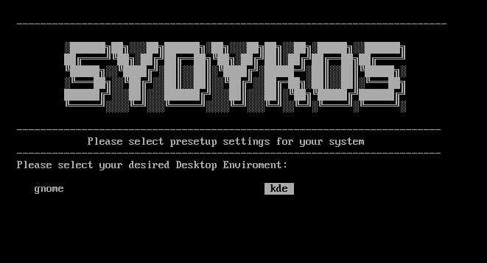
Screenshots of the GUI

Slide 23
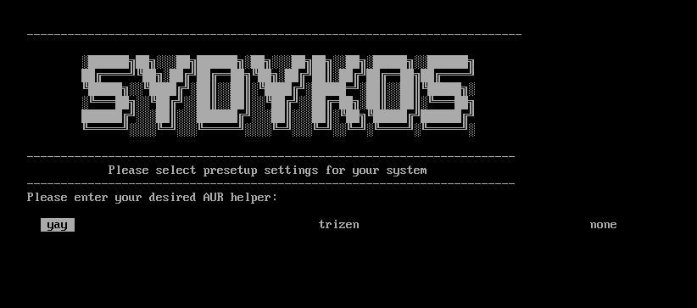
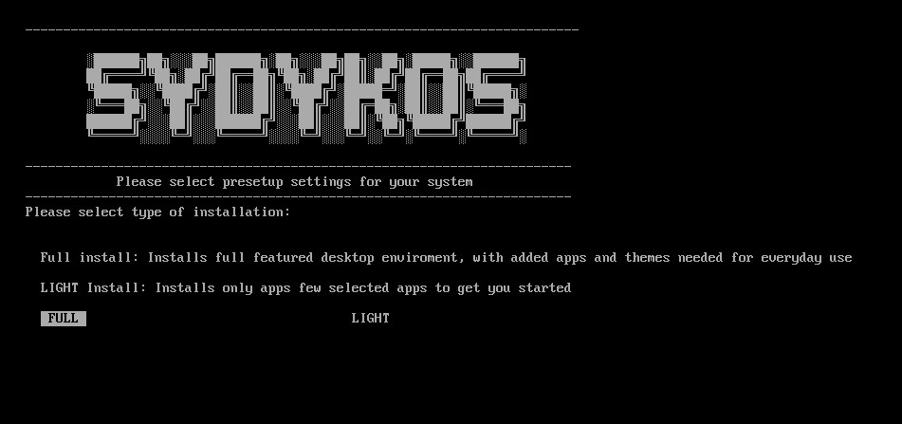

Slide 24
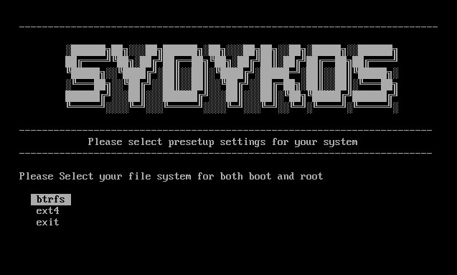
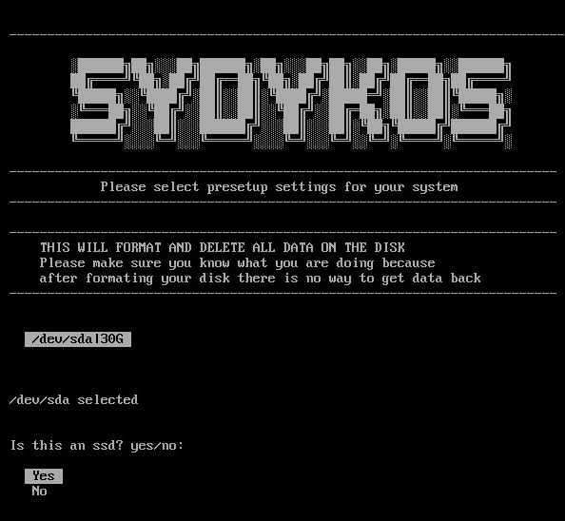
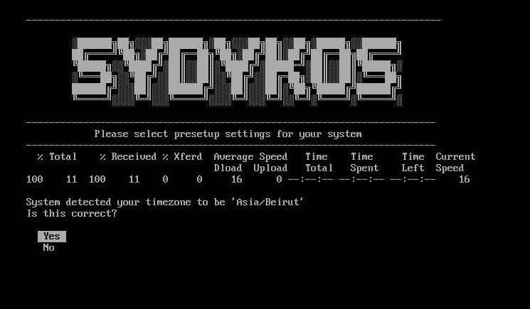

Slide 25
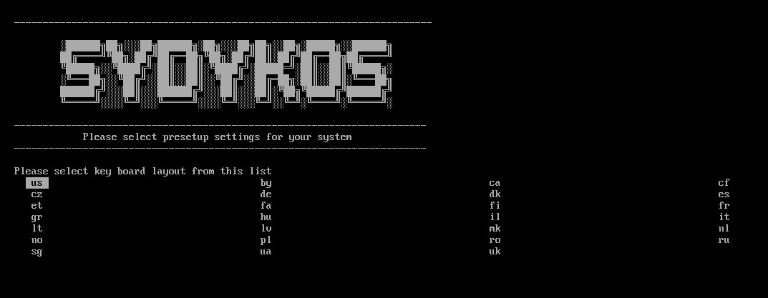
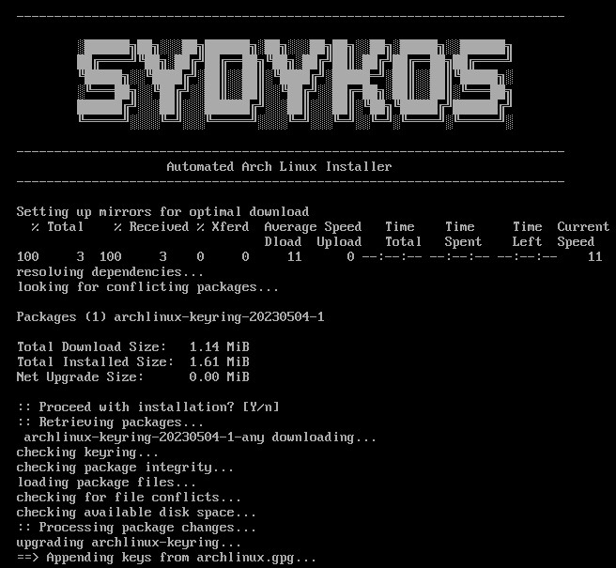
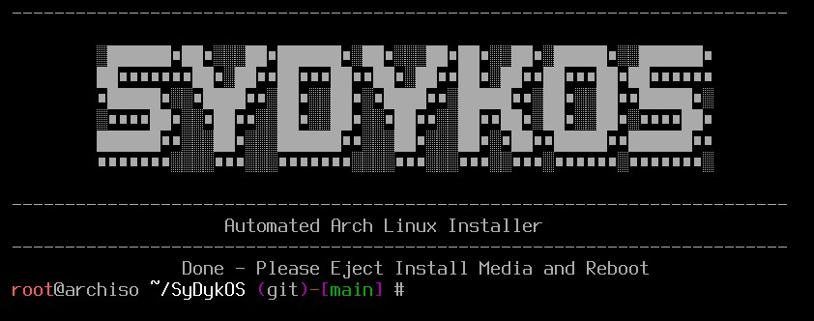

Slide 26
05
Results & Future Enhancements
- Results
- Potential future enhancements or development

Slide 27
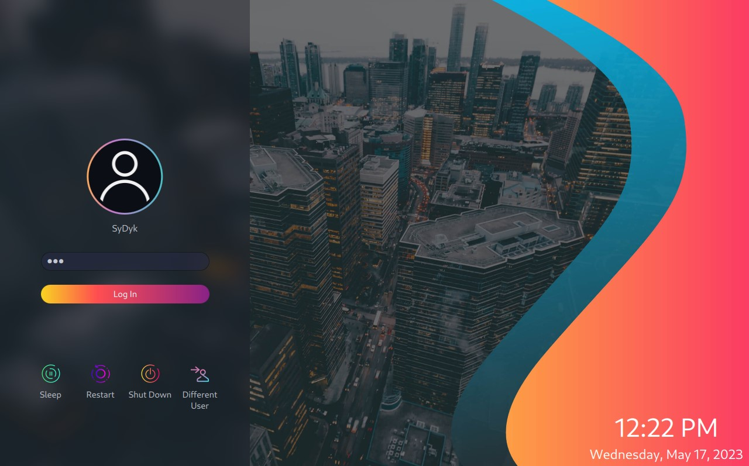
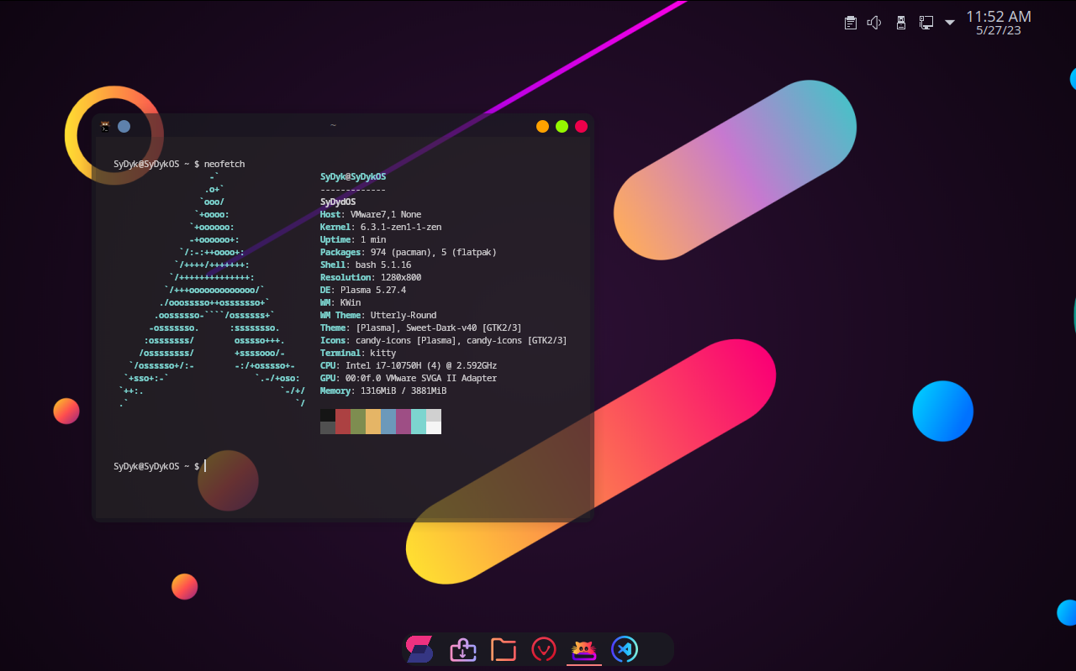
Results

Slide 28
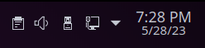
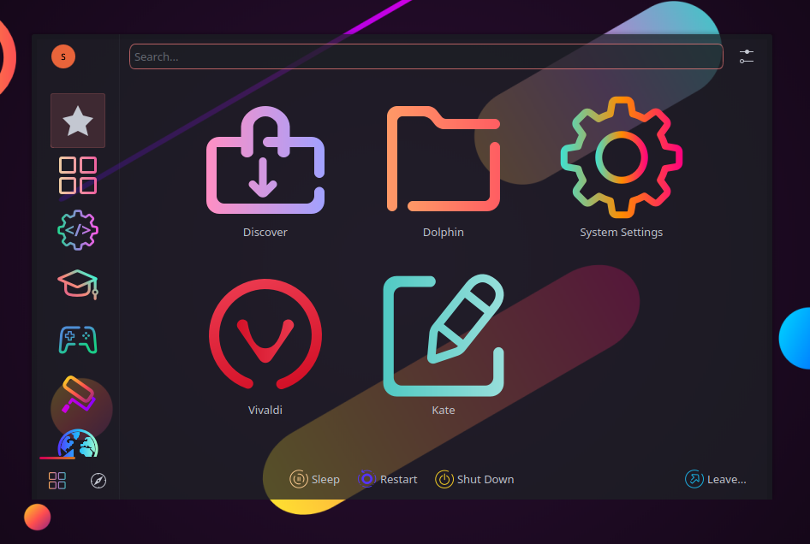


Slide 29


Potential future enhancements or development
Build a fully functioning ISO that integrates with the Calamares installer.
Optimize the post-install script.
Add additional desktop environments.
Build a secure version of the distro utilizing the Linux Hardened kernel and the LUKS encrypted filesystem.
Port the distro to other CPU architectures such as ARM and RISC-V.

Slide 30
06
Conclusion

Slide 31
Conclusions
SyDykOS offers a unique and modern Linux experience.
Performance and security focused thanks to the Linux-ZEN kernel.
SyDykOS is always up to date thanks to the rolling release model of Arch-Linux.
SyDykOS combined with the robustness of the KDE desktop environment, provides a user-friendly experience for both new and experienced Linux users.
With more time and and effort SyDykOS can be used as a daily driver.

Slide 32
Thank You
A HUGE thanks goes to the ArchMatic post-install GitHub project
A BIG thanks goes to the Arch-Linux Documentation and Forums

